Slide 1
Deep Hierarchical Encoder For Detecting Incongruity Between News Headline and Body Text
Presentation By: Under the supervision of:
Mohd Amzad Prof. Dr. Bashir Alam
M.Tech 4’th sem Dept. Computer Engg, JMI

Slide 2
Contents:
Introduction
Aim Of The Project
Literature Survey
Problem Definition
Methodology
Experiment
Partial Experiment Results
Work Done
Work left
References

Slide 3
Introduction
Misleading or false information in journalism has posed a critical social problem.
News headlines are known to play an important role in making first impressions to readers, and thereby deciding the viral potential of news stories within social networks .
Likewise, much of news sharing is headline-based; people circulate news headlines without necessarily having read the full news story.
Therefore, if a news headline does not correctly represent the news story — or is incongruent — it could mislead readers into advocating overrated or false information, which then becomes hard to revoke.
Identifying incongruent headlines in advance will better assist readers to choose which news stories to consume, thus decrease the chance of encountering unwanted information.

Slide 4
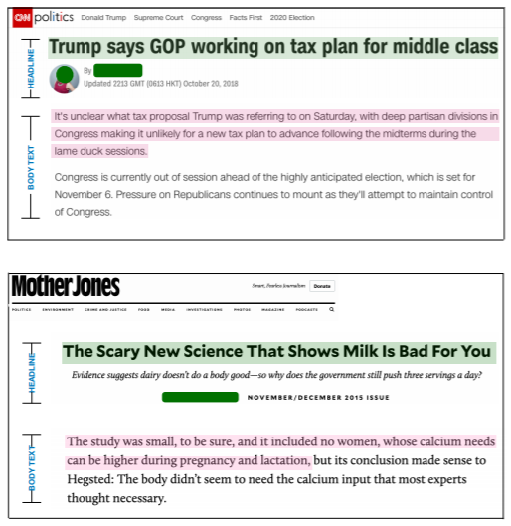
Most previous research tackling this problem has tried to detect incongruity in news headlines either by analyzing linguistic features of news headlines (Blom and Hansen 2015; Chen, Conroy, and Rubin 2015) or by analyzing the textual similarities between news headlines and body text (Ferreira and Vlachos 2016; Wang, Hamza, and Florian 2017).
This project, in an attempt to tackle the incongruent news headline problem, presents on a large-scale dataset.
We propose deep learning approaches that learn the complex textual relationship between the news headline and the full news content, which turned out to be critical for classifying incongruent headlines.
Figure 1: A news article example of the incongruent headline. (Ref.:ppr=MuSeM: Detecting Incongruent News Headlines using Mutual Attentive Semantic Matching)

Slide 5
2. Aim of the Project
To use a large-scale dataset for the incongruent headline problem, which covers almost all important news articles over a period of two year.
To propose a deep hierarchical models that encode the full news article from a word-level to a paragraph-level. Also to present a data augmentation method that splits news paragraphs and annotates each of them separately.
To train and test our models with real data. Manual verification successfully demonstrates the efficacy of our dataset in training of incongruent headlines.
To design the model with fewer parameter.
To study and compare the result obtained with many other baseline models.

Slide 6
3. Literature Survey
Author & Year | Paper title | Short Description
Eugenio Tacchini, Gabriele Ballarin, Marco L. Della Vedova, Stefano Moret, and Luca de Alfaro(2017) | Some Like it Hoax : Automated Fake News Detection in Social Networks | They present two classification techniques, one based on logistic regression, the other on a novel adaptation of boolean crowdsourcing algorithms.
Federico Monti, Fabrizio Frasca, Davide Eynard, Damon Mannion(2019) | Fake News Detection on Social Media using Geometric Deep Learning | The model was trained and tested on news stories, verified by professional fact-checking organizations, that were spread on Twitter.
Rowan Zellers , Ari Holtzman , Hannah Rashkin, Yonatan Bisk, Ali Farhadi, Franziska Roesner(2020) | Defending Against Neural Fake News | This paper investigates the threats posed by adversaries seeking to spread disinformation.A controllable language model named Grover – suggests that these threats are real and dangerous.
Yi-Ju Lu, Cheng-Te Li(2020) | GCAN: Graph-aware Co-Attention Networks for Explainable Fake News Detection on Social Media | Extensive experiments conducted on real tweet datasets exhibit that GCAN can significantly outperform state-of-the-art methods by 16% in accuracy on average. In addition, the case studies also show that GCAN can produce reasonable explanations.

Slide 7
Tanik Saikh,Arkadipta De, Asif Ekbal,Pushpak Bhattacharyya (2020) | A Deep Learning Approach for Automatic Detection of Fake News | The proposed systems yield encouraging performance, outperforming the current handcrafted feature engineering based state-of-the art system with a significant margin of 3.08% and 9.3% by the two models, respectively.
Chunyuan Yuan, Qianwen Ma, Wei Zhou, Jizhong Han and Songlin Hu(2020) | Early Detection of Fake News by Utilizing the Credibility of News, Publishers, and Users Based on Weakly Supervised Learning | They propose a novel Structure-aware Multi-head Attention Network (SMAN), which combines the news content, publishing, and reposting relations of publishers and users, to jointly optimize the fake news detection and credibility prediction tasks.
Seunghyun Yoon, Kunwoo Park, Minwoo Lee, Taegyun kim, Meeyoung Cha, And Kyomin Jung(2021) | Learning to Detect Incongruence in News Headline and Body Text via a Graph Neural Network | The model, called the graph-based hierarchical dual encoder (GHDE), utilizes a graph neural network to efficiently learn the content similarity between news headlines and long body paragraphs. This paper also releases a million-item-scale dataset of incongruity labels that can be used for training.
Rahul Mishra, Piyush Yadav, Remi Calizzano, Markus Leippold(2020) | MuSeM: Detecting Incongruent News Headlines using Mutual Attentive Semantic Matching | This paper proposes a method that uses inter-mutual attention-based semantic matching between the original and synthetically generated headlines, which utilizes the difference between all pairs of word embeddings of words involved.
Wei Wei and Xiaojun Wan(2017) | Learning to Identify Ambiguous and Misleading News Headlines | For the identification of misleading headlines, they extract features based on the congruence between headlines and bodies.Then they use classifiers to detect inaccurate headlines crawled from different sources and conduct a data analysis.

Slide 8

4. Problem And Dataset
A.Problem Definition
The specific problem we tackle is the Headline Incongruence Problem (Chesney et al. 2017), where a headline of news article holds unrelated or distinct claims with the stories across its body text. Such incongruity in news stories is a major characteristic as clickbait. Figure 1 demonstrates a representative example of such misinformation. The catchy news headline promises to tell certain benefits of yoga, yet the body text mainly is an advertisement for a new yoga program.
Figure 1: A news article example of the incongruent headline(Ref ppr.: 2).

Slide 9
B.Dataset
We have downloaded the ‘News Headlines Dataset For Sarcasm Detection’ from keggle. This is a high quality dataset created by Rishabh Mishra.
Since news headlines are written by professionals in a formal manner, there are no spelling mistakes and informal usage. This reduces the sparsity and also increases the chance of finding pre-trained embeddings.
To overcome the limitations related to noise in like in Twitter datasets, this News Headlines dataset for Sarcasm Detection is collected from two news website.
Then the word tokens were transformed to integers, which will help to utilize the dataset without the language barrier.
About the dataset file
Each record consists of three attributes:
is_sarcastic: 1 if the record is sarcastic otherwise 0
headline: the headline of the news article
article_link: link to the original news article. Useful for collecting supplementary data

Slide 10
Training Set Creation:
It is almost impossible to manually investigate million-scale news articles for any task. Hence, we automatically generated labels on crawled news articles.
Rather than crafting new headlines, we implanted unrelated or topically-inconsistent content into body text of original news articles.
Hence, the automation process for creating incongruent-labeled data involves the following steps:
(1) sampling a target article from the corpora,
(2) sampling part-of content from another article of the corpora, and
(3) inserting this part-of-content to the target article.
2. Paragraph Set Creation:
The task of detecting incongruent headlines can be converted into a set of subproblems that inspect the textual relationship between a headline and each paragraph respectively, rather than examining the relationship between the headline and whole article content at once.
Thus we created the paragraph dataset that transforms a pair of {headline} and {body text} into multiple sub-pairs of {headline} and {paragraph}.
In generating incongruent-labeled data, we sampled {headline} and {paragraph} from different articles and then matched them as pairs.
And we created incongruent- and congruent labeled datasets and maintained train, development, and test datasets that do not overlap each other

Slide 11
5. Methodology
Our objective is to determine whether a news article contains an incongruent headline, given a pair of {headline} and {body text}. We call the output probability being incongruent headline as incongruence score in this Project.
Baseline approaches
Feature-based ensemble algorithms have been widely utilized for their simplicity and effectiveness.
As a baseline, we implemented the XGBoost (XGB) classifier by utilizing the set of features to calculate the cosine similarities between the {headline} and {body text}.
Recurrent Dual Encoder (RDE)
A recurrent dual encoder that is consisted of dual RNNs has been utilized to calculate a similarity between two text inputs.
When RNN encodes word sequences, each word is passed through a word-embedding layer that converts a word index to a corresponding 300- dimensional vector.
After the encoding step, the probability of being incongruent headline is calculated by using the final hidden state of each {headline} and {body text} RNNs.
The incongruence score in the training objective is as follows:
p(label) = σ((h_{th}^{H})^{T} M h_{th}^{B} + b), ………….…...eq(1)
L = − log 𝚷_{n=1}^{N} p(label_{n} | h_{n,th}^{H} , h_{n,tb} ^{B}) ……………..eq(2)

Slide 12
Convolution Dual Encoder (CDE)
Taking the word sequence of {headline} and {body text} as input to the convolutional layer, we obtained a vector representation
v = {v_{i} |i = 1, · · · , k}
For each part of the article through the max-over-time pooling after computing convolution with k filters as follows:
v_{i} = g(f_{i}(W)), ……..eq(3)
We use dual CNNs to encode the {headline} and the {body text} into vector representations.
Proposed methods
CDE learns local dependencies between words, its typical length of convolutional filter keeps the model from capturing any relationship between the words in distinct positions.
The average word count in our news corpus is 518.97.
We fill this gap by proposing neural architectures that efficiently learn hierarchical structures of long text sequences.
We also present a data augmentation method that efficiently reduces the length of the target content while increasing the size of the training set.
Attentive Hierarchical Dual Encoder (AHDE)
This model splits text into a list of paragraphs and encodes the entire text input from the word-level to the paragraph-level via employing a two level hierarchy of the RNN architecture.
We adopt bi-directional RNNs in paragraph-level RNN to exploit information both from the past and the future.

Slide 13
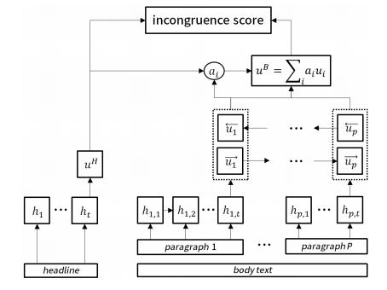
Figure 2 depicts a diagram of the model. For each paragraph, the word-level RNN encodes the word sequences w_{p} = {w_{p,1:t}} to h_{p} = {h_{p,1:t},}.
The hierarchical architecture can learn textual patterns of news articles with fewer sequential steps for RNNs compared to the steps required for RDE.
AHDE only accounts for 62.0 and 8.37 steps for each level of RNN, on average.
The hidden states of hierarchical RNNs are as follows: h_{p,t} = f_{θ}(h_{p,t-1}, w_{p,t}), ……..eq(4)
u_{p} = g_{θ}(u_{p-1}, h_{p}). ……..eq(5)
Then, each u_{p} of {body text} is aggregated according to its correspondence with the {headline} as follows: s_{p} = v^{T} tanh(W^{B}_{u} u^{B}_{p} + W^{H}_{u} u ^{H}),..eq(6)
a_{i} = exp(s_{i})/ ∑_{p} exp(s_{p}), ……..eq(7)
u^{B} = ∑_{i} a_{i,}u_{i}^{B} ………...eq(8)
We use the same training objective as the RDE model, and the incongruence score is calculated as follows:
p(label) = σ((u^{H}) |M u^{B} + b) ……..eq(9)
Figure 2: A diagram of the AHDE model.

Slide 14
Hierarchical Recurrent Encoder (HRE)
The AHDE model uses two hierarchical RNNs for encoding text from word-level to paragraph-level.
The text in the news {body text} is split into paragraphs, each of which is embedded by averaging the word-embedding vector from its containing words.
HRDE calculates h_{p} in equation (4) by averaging the word embedding among the words in paragraph p,
h_{p} = ∑_{i} embedding(w_{i}), w_{i} ⊂ p-th paragraph. …….eq(10)
Then, paragraph-level RNN is applied with the paragraph-encoded sequence input, h_{p}, for retrieving the final encoding vector of the whole {body text}.
Independent Paragraph (IP) Method
The final incongruence score for the pair of {headline} and {body text} is determined as the maximum score of incongruence scores as follows:
p(label) = max(s_{1:p}) ……….eq(11)
The selection of the maximum score can better identify news articles which contain a paragraph that is highly unrelated to the news headline.

Slide 15
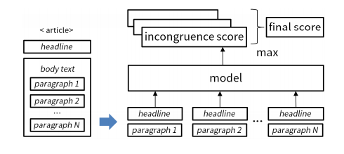
Figure 3 depicts the diagram of the IP method, which computes incongruence score for each paragraph from its relationship with the news headline.
For training models with IP method, we use the paragraph dataset and incongruence scores are calculated in the following ways:
• XGB/SVM with IP: Extracting features from {headline} and each paragraph of {body text}, XGB/SVM measures the incongruence score for each paragraph.
• RDE/CDE with IP: Both models encode word sequences in each paragraph of {body text} and compare them with the encoded {headline}.
• AHDE with IP: To encode each paragraph in {body text}, the first-level RNN encodes word sequences for each sentence and the second-level RNN takes a sequence of sentences as input, which is retrieved from the first level RNN.
• HRE with IP: To obtain the incongruence score for each paragraph, HRE first calculates the mean of word vectors for each sentence. Then, RNN encodes a sequence of sentences by taking the averaged word vectors as input.
Figure 3: Diagram of the independent paragraph method.

Slide 16
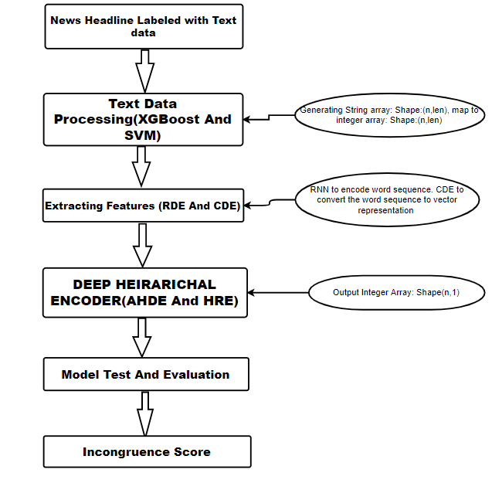
Figure 4: flowchart showing the various modules of the Deep Hierarchical Encoder

Slide 17
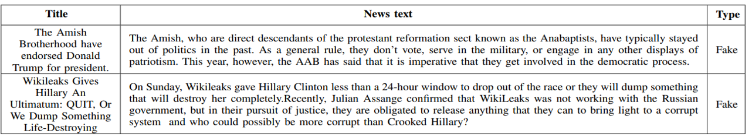
6. Experiment
Case Study:
Table 1
At first, we manually inspected the random samples of news articles to see whether they have incongruent headlines.
We use 80% of the data for training, 10% of the data for validation and 10% of the data for testing. All the experiments are run at least 10 times separately.

Slide 18
2. Preprocessing
Prior to training models, we perform the following pre-processing steps:
Filtering headlines:-We remove all non-alphanumeric characters from the text, but we keep all stop words because our model trains the sequence of words in a text directly.
We replace all user mentions and hashtags with a blank space and skip images , flags from the posts.
We replace the URLs with the string ‘http‘. And define max features.
Vectorize & Convert text for input.
Splitting data to train & test.

Slide 19
3. Experimental setup
All the experiments were performed using Python and some modules are build and trained in google colab.
Tokenizer is used to vectorize and convert text into Sequences so that the Network can deal with it as input.
Optimization was done using Adam and sigmoid as an activation function..
We trained each classifier model with a batch size of 32. In all the approaches, we used only the first token output provided by each model as input to classifier layer.
For the evaluation, we have used weighted f1 score as a metric for measuring the performance in both the classification and detection tasks.
To measure the combined performance of 4 individual baseline models together, we have used weighted fine-grained f1 score as the metric, where the weights for the scores of individual classes are the fraction of their positive examples.
We apply IP data augmentation method to all six models and that gives an increase in performance.
Whether using the IP method or not, the newly proposed HRE and AHDE model consistently showed competitive performance irrespective of the paragraph size in {body text}.

Slide 20
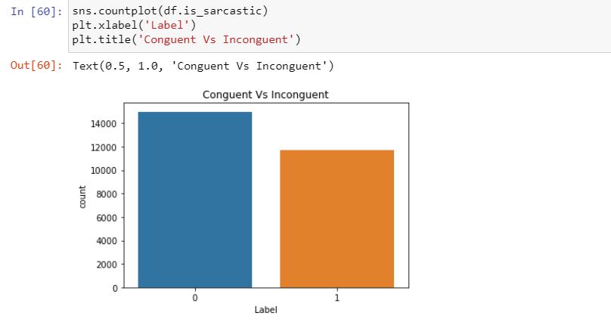
7. Partial Experiment Result
Normalization
Screenshot 1;

Slide 21
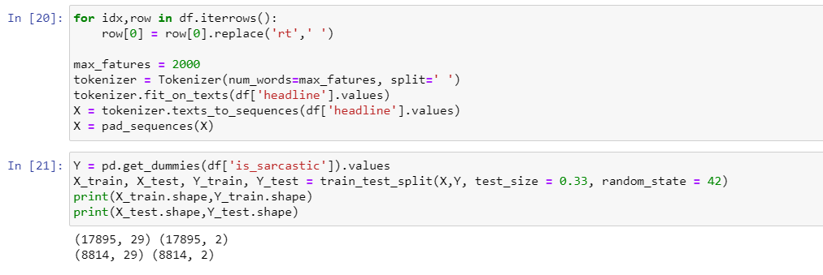
B. Splitting data to train & test
Screenshot 2;

Slide 22
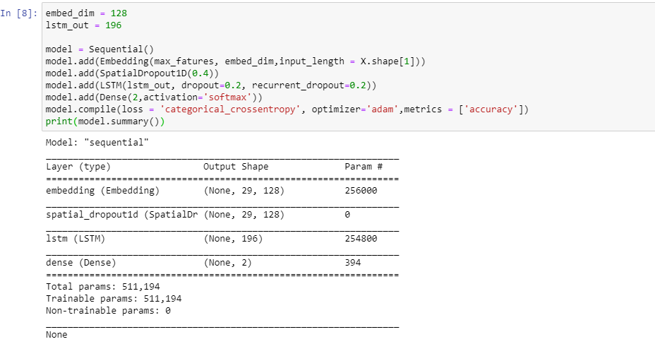
C. Defining The model
Screenshot 3;

Slide 23
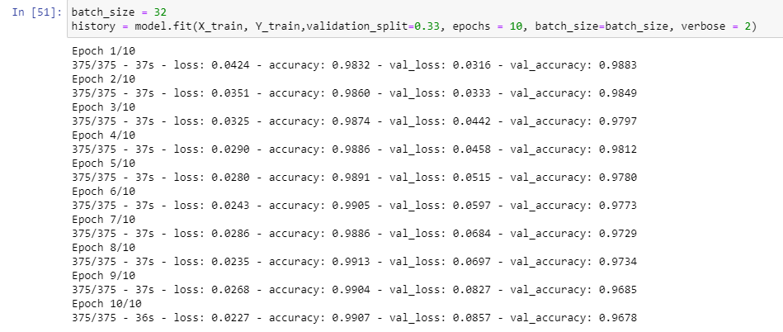
D. Training The Model
Screenshot 4;

Slide 24
8. Work Done
Contributions of this project are summarized as follows:
We have downloaded a large dataset and the corpus is composed of pairs of news headlines and body text along with the annotated incongruity label.
We propose deep hierarchical models that encode the full news article from a word-level to a paragraph-level.
We also present a data augmentation method that splits news paragraphs and annotates each of them separately.
We have build two models required to find the incongruence score . They are AHDE and HRE.
We have calculated and plot the difference between congruent and incongruent headlines in a dataset.
We have trained the model with fewer parameters.

Slide 25
9. Work left
The dataset in this project focuses on the news from limited websites. We will crawl more data from more websites to further investigate the differences between real and fake news in other languages.
To calculate the accuracy, precision, recall and fi-score of the complete model.
To plot the accuracy and loss vs epochs.
To calculate the incongruence scores of the headlines.
To study the effectiveness of several parameters in the proposed model:
- the word embedding dimensions,
-batch size,
-the hidden layer dimensions,
-the dropout probability and filter size.
To compare the performances using whole dataset with the IP method on paragraph dataset with other baseline models.

Slide 26
10. References
1. Tacchini, Eugenio, et al. "Some like it hoax: Automated fake news detection in social networks." arXiv preprint arXiv:1704.07506 (2017).
2. Yoon, S., Park, K., Lee, M., Kim, T., Cha, M., & Jung, K. (2021). Learning to Detect Incongruence in News Headline and Body Text via a Graph Neural Network. IEEE Access, 9, 36195-36206.
3. Monti, Federico, et al. "Fake news detection on social media using geometric deep learning." arXiv preprint arXiv:1902.06673 (2019).
4. Zellers, Rowan, et al. "Defending against neural fake news." arXiv preprint arXiv:1905.12616 (2019).
5. Lu, Yi-Ju, and Cheng-Te Li. "GCAN: Graph-aware co-attention networks for explainable fake news detection on social media." arXiv preprint arXiv:2004.11648 (2020).
6. Saikh, Tanik, et al. "A deep learning approach for automatic detection of fake news." arXiv preprint arXiv:2005.04938 (2020). 7. Yuan, Chunyuan, et al. "Early Detection of Fake News by Utilizing the Credibility of News, Publishers, and Users Based on Weakly Supervised Learning." arXiv preprint arXiv:2012.04233 (2020).
8. Kamal, Ojasv, Adarsh Kumar, and Tejas Vaidhya. "Hostility Detection in Hindi leveraging Pre-Trained Language Models." arXiv preprint arXiv:2101.05494 (2021).
9. Bhatt, Gaurav, et al. "On the benefit of combining neural, statistical and external features for fake news identification." arXiv preprint arXiv:1712.03935 (2017).

Slide 27
10.Yang, Yang, et al. "TI-CNN: Convolutional neural networks for fake news detection." arXiv preprint arXiv:1806.00749 (2018).
11. Nguyen, Duc Minh, et al. "Fake news detection using deep markov random fields." Proceedings of the 2019 Conference of the North American Chapter of the Association for Computational Linguistics: Human Language Technologies, Volume 1 (Long and Short Papers). 2019.
12. Saikh, Tanik, et al. "A Deep Learning Approach for Automatic Detection of Fake News." arXiv preprint arXiv:2005.04938 (2020).
13. Umer, Muhammad, et al. "Fake news stance detection using deep learning architecture (cnn-lstm)." IEEE Access 8 (2020): 156695-156706.
14. Cui, Limeng, et al. "defend: A system for explainable fake news detection." Proceedings of the 28th ACM International Conference on Information and Knowledge Management. 2019.
15. Girgis, Sherry, Eslam Amer, and Mahmoud Gadallah. "Deep learning algorithms for detecting fake news in online text." 2018 13th International Conference on Computer Engineering and Systems (ICCES). IEEE, 2018.
16.Thota, Aswini, et al. "Fake news detection: a deep learning approach." SMU Data Science Review 1.3 (2018):
17. Sahoo, Somya Ranjan, and B. B. Gupta. "Multiple features based approach for automatic fake news detection on social networks using deep learning." Applied Soft Computing 100 (2021): 106983.
18. Girgis, Sherry, Eslam Amer, and Mahmoud Gadallah. "Deep learning algorithms for detecting fake news in online text." 2018 13th International Conference on Computer Engineering and Systems (ICCES). IEEE, 2018.
19. Zhang, Jiawei, et al. "Fake news detection with deep diffusive network model." arXiv preprint arXiv:1805.08751 (2018).
20.Wei, Wei, and Xiaojun Wan. "Learning to identify ambiguous and misleading news headlines." arXiv preprint arXiv:1705.06031 (2017).
21.Mishra, Rahul, et al. "MuSeM: Detecting incongruent news headlines using mutual attentive semantic matching." 2020 19th IEEE International Conference on Machine Learning and Applications (ICMLA). IEEE, 2020.

Slide 28
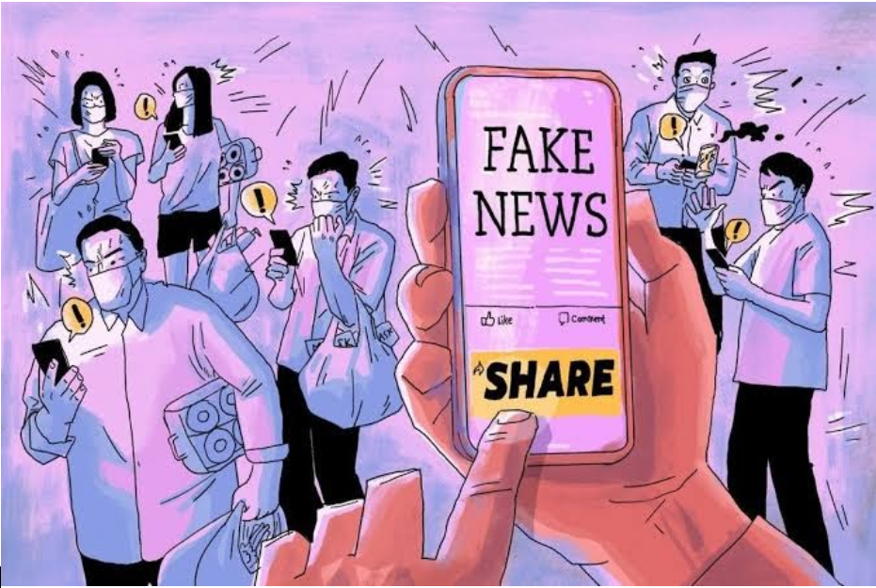
Thank You

